Slide 1
User Workflow
Stephen Reaves, Christopher Skeen, Christopher Bowling, Bobby Jones, Ian Finch

Slide 2
XML Builder
After receiving spec sheets from suppliers, enter that info into the XML Builder.
The XML Builder will structure the Assembly Order, while maintaining other metadata.
Simple application that allows users to organize “order tree” and save to a file.

Slide 3
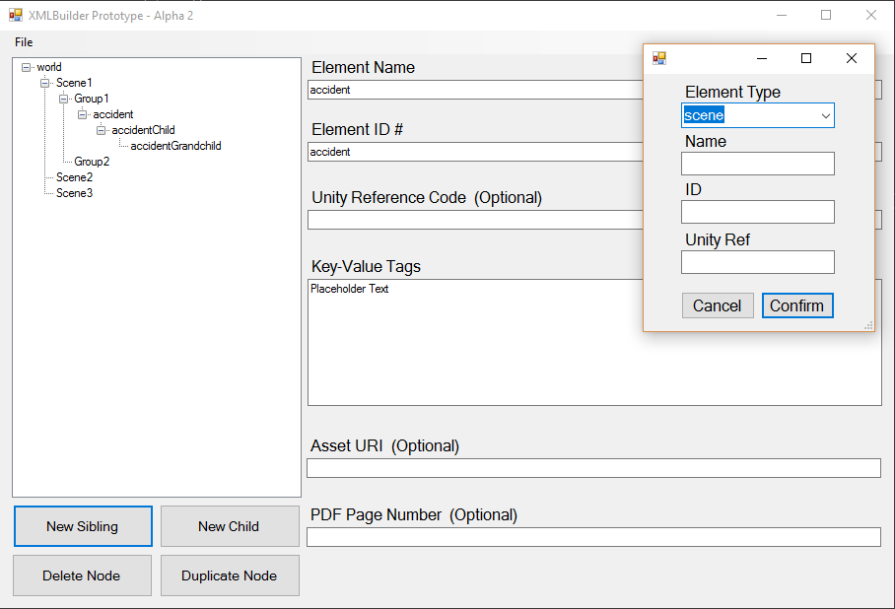
XML Builder Screenshot

Slide 4
Import into Unity
Specify XML file to build “order tree” from
Type in file name
Drag and Drop
Unity will signify which object is next in assembly process
Numbered for Linear Assembly
Colored for Arbitrary Assembly

Slide 5
Virtual Reality
Use headset and controllers to assemble parts in VR.
User should be able to follow the prompts provided by the program to assemble the parts, even with no prior knowledge of the parts.

Slide 6
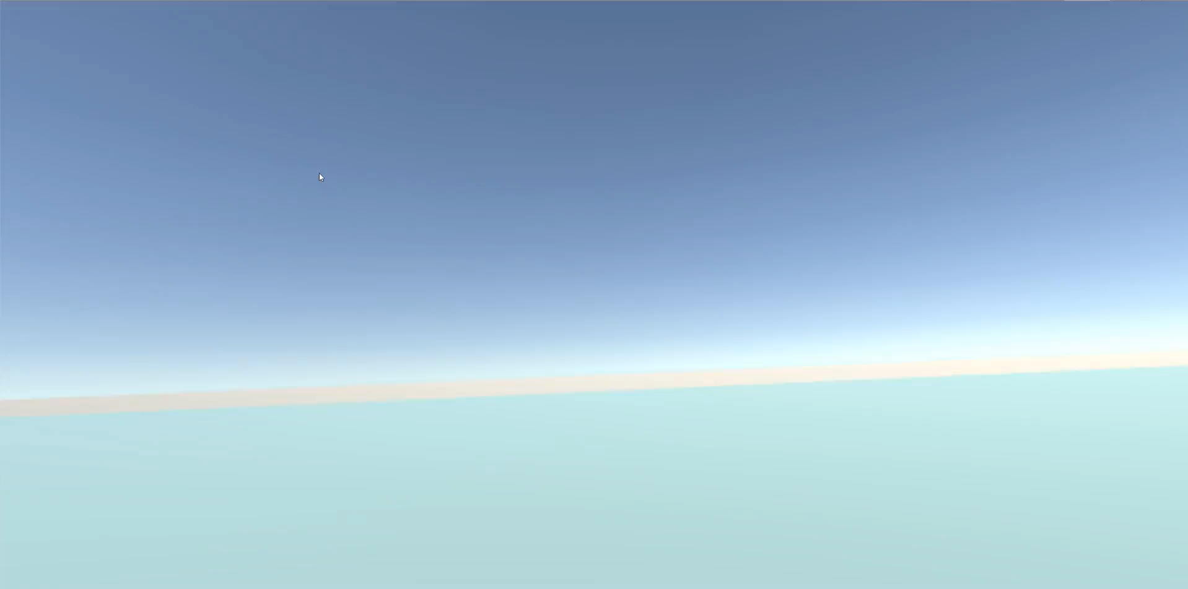
Video Demo

